Slide 1
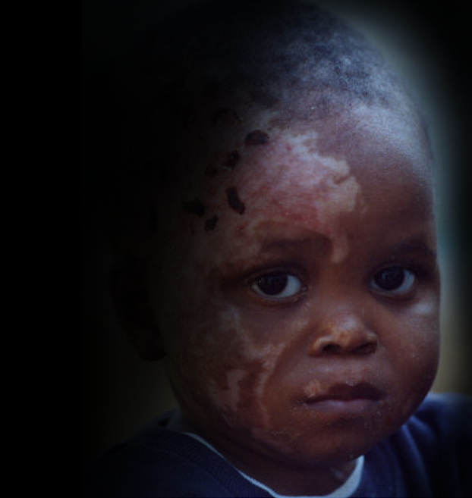
Burn injuries in children
Statistics
Record keeping at hospitals

Slide 2
Aims of research on burn epidemiology
To determine most common factors involved in childhood burn injuries
  Age group
  Mechanism of injury
  Season
  Social circumstances
Thus to develop effective prevention strategies

Slide 3
Research at Johannesburg Academic Hospital – Overview
Paediatric patients age 0 to 16 years
Patients admitted for fresh burns as well as old burns (reconstructive surgery)
Records obtained from casualty department , surgical and orthopaedic wards
Divided into two groups according to available data: Jan – Aug 2002 and Jan – Dec 2003

Slide 4
Group 1
71 patients over 8 months
Fields analysed:
  age, sex
  type and location of burn
  percentage of body surface affected
  depth of burn

Slide 5
Age, sex and body surface area
Mean age: 3 years 9 months
Male patients: 59%
Female patients: 41%
Mean percentage of body surface area burned: 9.96%
Ratio 1.4 : 1

Slide 6
Figure: Types of injuries

Slide 7
Age groups
Group 1 (0-11 months): 15 (23.4%)
  10 scalds, 2 flame, 1 electric, 1 contact, 0 blasts
Group 2 (1 – 3 years): 30 (46.9%)
  25 scalds, 2 flame, 1 electric, 1 contact, 0 blasts
Group 3 (4 – 6 years): 5 (7.8%)
  1 scald, 3 flame, 0 electric, 0 contact, 0 blasts

Slide 8
Figure: Age groups and types of injuries

Slide 9
Age groups
Group 4 (7 – 9 years): 7 (10.9%)
  2 scalds, 1 flame, 1 electric, 0 contact, 1 blast
Group 5 (10 – 12 years): 4 (6.5%)
  0 scalds, 1 flame, 1 electric, 0 contact, 2 blasts
Group 6 (13 – 16 years): 3 (4.7%)
  0 scalds, 1 flame, 1 electric, 0 contact, 1 blast

Slide 10
Figure: Age distribution

Slide 11
Figure: Age distribution and types of burns

Slide 12
Type of burn and anatomical location
Most scalds (59 %) affected one or both forearms
Most flame burns (66 %) affected the legs
Most electric burns, contact burns and blast injuries affected the hands

Slide 13
Group 2
193 patients over 12 months
Fields analysed:
  Month of injury
  Age and sex

Slide 14
Age and sex
Mean age: 3 years 0 months
  Range 1 month to 15 years 9 months
Male patients: 62%
Female patients: 38%
Ratio 1.6 : 1

Slide 15
Monthly distribution

Slide 16
Record keeping
Difficulties encountered:
Missing books/files
Inconsistent or wrong information
Lack of detail necessary to draw conclusions
  E.g. “Injury middle finger” referred to an electrical burn to the right hand middle finger
Incomplete entries
Illegible hand-written entries

Slide 17
Figure: Missing and available records

Slide 18
Examples of lack of detail
Out of 193 diagnoses:
110 stated only “burns”, “burns dressing”, “burns revision” or “septic burns”
50 stated the anatomical location of the burn, and 13 of those also gave the depth, mechanism or body surface area
12 stated the type of burn, and only 3 of those also stated the body surface area

Slide 19
Examples of incomplete entries
Out of 193 entries the following information was omitted:
Address (26 times)
Sex (11 times)
Age (6 times)
Hospital registration number (twice)
Name (once)

Slide 20
Recommendations
Tick-list / questionnaire for burn patients
Simple drawing to indicate location of burn
Records kept in hard copy and electronically
Conscientious record-keeping enforced by middle and senior management
Detailed records are important, not only for research

Slide 21
Future Hospital Information System
Rolled out across Gauteng Province
Electronic records
  Details of every visit to hospital/clinic stored
Accessible from all clinics and hospitals of the province
Fully implemented across province over next three years

Slide 22
Contact information
Email: firechildren@icon.co.za
Website: www.firechildren.org

